Slide 1
Scalable Methods for 8-bit Training of Neural Networks
Paper by: Ron Banner , Itay Hubara , Elad Hoffer, Daniel Soudry
Presented by: Pavel Rastopchin, Nicolas Munerman

Slide 2
Previous work
Several works have shown that training at 16-bit is sufficient for most networks.
In the extreme case, the quantization process used only one bit which resulted in binarized neural networks (BNNs).
Batch normalization is a bottleneck for network quantization and is either replaced by a constant scaling layer, or avoided.
In current paper 8-bit precision enables training with no loss of accuracy and without modifying the original architecture. 8-bit quantization is better suited for future and current hardware.

Slide 3
Proposed method
Range Batch-Normalization (Range BN)
- Efficient BN under certain assumptions regarding input.
- Quantization to 8bit.
Quantized Back Propagation
- Quantization of activations, weights, and gradient to 8-bit

Slide 4


Range Batch-Normalization (Range BN)
Traditional batch involves sums of squares that can lead to arithmetic overflows in quantized models:
Assuming the input follows a Gaussian distribution, the range of the input is highly correlated with the standard deviation magnitude. i.e.
Range BN normalizes each dimension:

Slide 5


Quantized Back Propagation
Backward pass requires twice the amount of multiplications compared to the forward pass, quantizing the gradients is a crucial step towards faster training machines.
Each layer needs to derive two sets of gradients
- Layer activation gradients for streaming backward:
Weights gradients for weight update:
Weight gradient is not required for the sequential process of BP, thus this matrix multiplication kept in full precision.

Slide 6
Proposed improvement
TBD

Slide 7
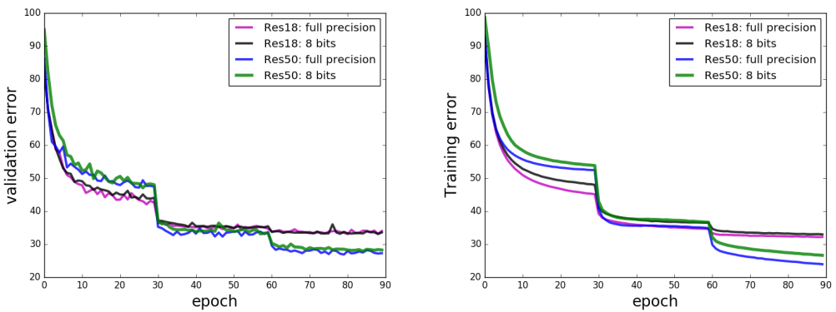
Experiment results on ImageNet dataset
Comparing a full precision run against 8-bit run with Quantized Back-Propagation and Range BN.

